Slide 1
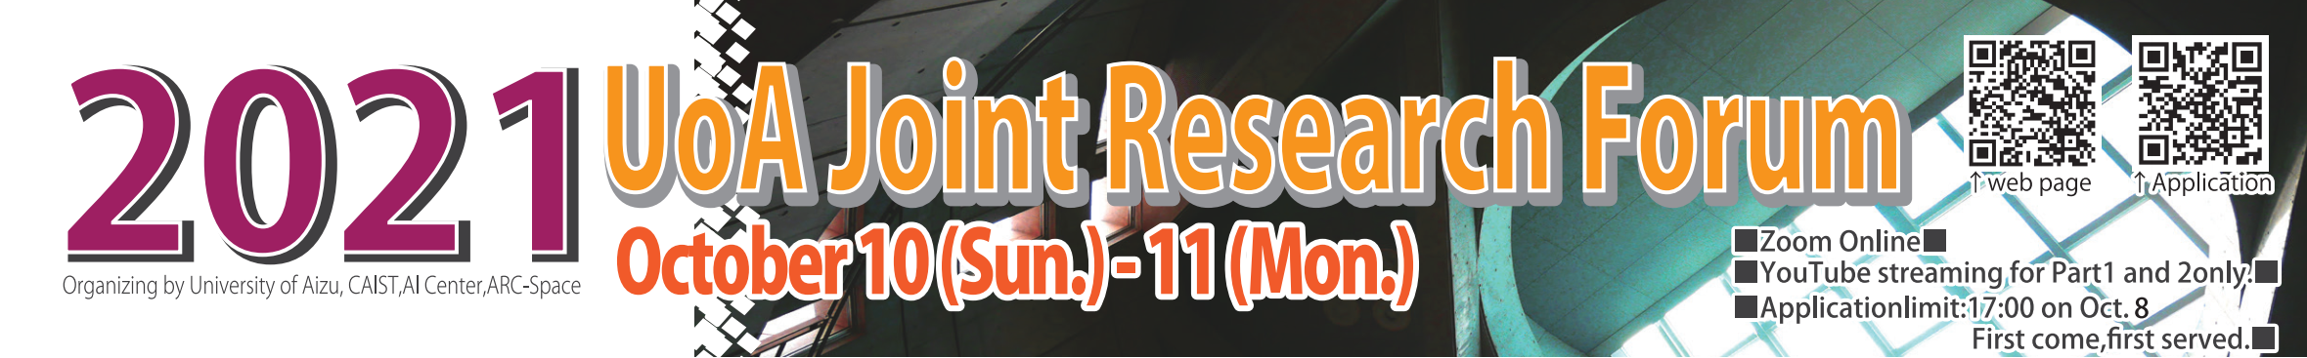
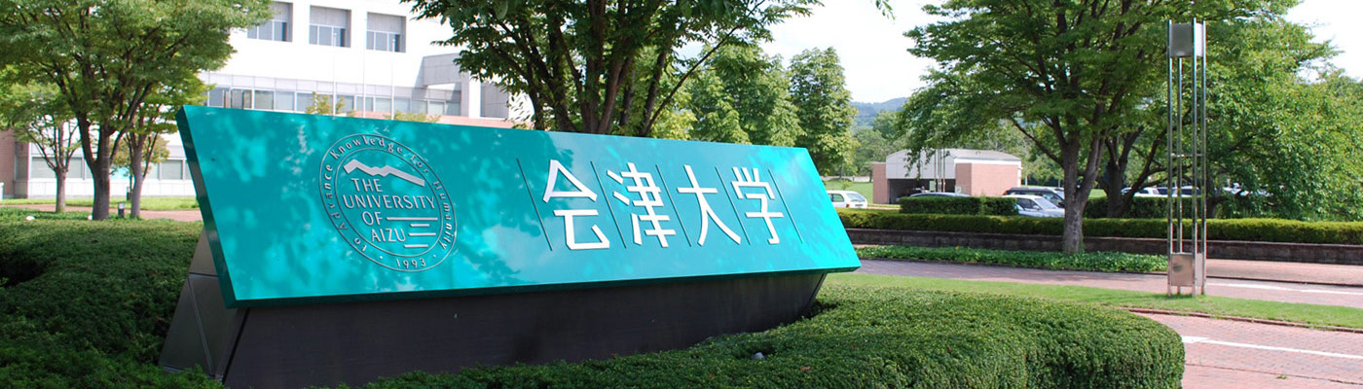
Vision and Sensor-Based System for
Human Activity Recognition and
Automatic Control using
Machine Learning
Dr. Jungpil SHIN
Pattern Processing Lab. The University of AIZU, JAPAN E-mail: jpshin@u-aizu.ac.jp
Notes:
Good morning! My name is Jungpil SHIN, in Pattern Processing Lab. UoA. １０：３５ １１：００ 13:08
The presentation Title is Vision and Sensor-Based System for Human Activity Recognition and
Automatic Control using Machine Learning
こんにちは、パターン処理学講座のシンです。
タイトルは 機械学習に基づいた、画像とセンサデータによる人間の行動認識と移動体の自動制御システム です。

Slide 2

Vision Computing Platform Cluster
Research Power Reinforcement
Principal Investigator: Dr. Jungpil SHIN
Pattern Processing Lab. The University of AIZU, JAPAN E-mail: jpshin@u-aizu.ac.jp
Notes:
The Given Cluster name is ..
The Tentative Cluster name for the Research Power Reinforcement is ..

Slide 3
Vision Computing Platform Cluster (Shin, Okuyama, Tomioka, Nishimura, Asai, Suzuki)
The Purpose of Cluster-Project :
The mission of this cluster is to develop and improve strategies to enhance collaboration and interaction on the research topics, such as pattern recognition, human-computer interaction, computer vision and image processing, computer graphics, and embedded systems.
This group conducts research and development of algorithms for control and decision making using the functionality of DNN, and images and videos are considered as input.
The research plan relies on novel interactions, mixed realities, visualizations, and collaborative technologies to promote HCI and autonomous driving.
Human Computer Interaction
Image Processing
Pattern Recognition
Computer Vision
Embedded System
Computer Graphics
Vision Computing Platform Cluster (Shin, Okuyama, Tomioka)
Notes:
The Cluster-Project Purpose:
The mission of this cluster is to develop and improve strategies to enhance collaboration and interaction on the research topics, such as pattern recognition, human-computer interaction, computer vision and image processing, computer graphics, and embedded systems.
This group conducts research and development of algorithms for control and decision making using the functionality of DNN, and images and videos are considered as input.
The research plan relies on novel interactions, mixed realities, visualizations, and collaborative technologies to promote HCI and autonomous driving
クラスター・プロジェクトの目的
このクラスターの目的は、
パターン認識、ヒューマン・コンピュータ・インタラクション、コンピュータビジョンと画像処理、コンピュータグラフィックス、組み込みシステムなどの
研究テーマについて、共同研究や相互の情報交換を強化していくことです。
このグループでは、画像を主要な入力としたシステムにおいて、
深層学習の機能を利用した制御や意思決定のためのアルゴリズムの研究開発を行います。

Slide 4
Vision Computing Platform Cluster (Shin, Okuyama, Tomioka, Nishimura, Asai, Suzuki)
Role of each member;
1) SHIN, Jungpil Coordinator, Implementation and test of applications
2) OKUYAMA, Yuichi Maintaining estimation and automatic control, optimization of the networks,
3) TOMIOKA, Yoichi Acceleration of vision applications
4) NISHIMURA Satoshi Implementation of Image Generation.
5) SUZUKI Taro Implementation of HCI network in differentiable functional language.
6) ASAI Nobuyoshi Experiment of proposed(optimized) network.
Human Computer Interaction
Image Processing
Pattern Recognition
Computer Vision
Embedded System
Computer Graphics
Keywords : Human-computer interaction, Hand Gesture, Non-touch interface, Handwriting action, Video-based sensors, Automatic control, Medical diagnosis and recognition, Deep learning
Notes:
Human-computer interaction (HCI) is a multidisciplinary field of study focusing on the design of computer technology and, in particular, the interaction between humans (the users) and computers.
There are different types of applications such as, Human-computer interaction, touch free interface, air-writing, virtual reality, brain-computer interface etc.
Recently, gesture recognition plays an important role in HCI especially the hand is the most convenient and direct way of expressing our feelings compared to the other part of the body
The depth camera can capture RGB information as well as depth information and is effective as a non-touch interface
下記のコメントは微妙です。
１．画像の入力をメインとしたDNNを扱う
We use DNNs that deal with image/videos.
２．画像から、機器を制御するための情報を取り出す。
または、画像から直接機器を制御する。
The system contains DNN part and desision-making part.
DNNs extract information to control devices from images, and the pass the result to desition-makeing part.
Desision-making part makes dicitions to control devices and/or show results to human.
３．機器の制御は、教師あり学習から始める。
システムの効率を上げるために、自律的に学習し、制御を更新する技術を導入する。
制御を人間と協調して更新できるよう、DNNの判断の根拠を人間に説明する仕組みを作る。
We start from supervised lerning. We introduce autonomous learining/updating technologies in the disition-making part.
In order to update control part collaborate with human and AIs, we implement explanation technologies of AI decisions.
In explanation, we need computer graphics/AR technorogies to show the result.

Slide 5
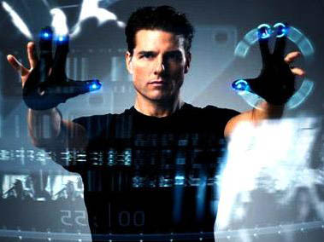

Introduction: Research Themes
The Project Purpose:
Research and analysis concerning Vision Computing
Vision Computing Platform Cluster
Non-touch Interface
Parkinson’s Disease Diagnosis
Handwriting Analysis and Recognition
Human Computer Interaction
User Authentic-cation
Handwriting Synthesis
Human Gesture Recognition
Automatic Control
ADHD Diagnosis
Notes:
In our cluster, Vision Computing Platform Cluster,
The following research themes are carried out.
Today I would like explain one theme the related on 3 Theme, HCI/ Non touch / Gesture.
ビジョンコンピューティングプラットフォームクラスタではこのようなテーマを実施しています。
ヒューマン・コンピュータ・インタラクション、
ノンタッチインターフェース、
人間のジェスチャー認識,
自動制御
パーキンソン病診断
ＡＤＨＤ診断
手書き文字の分析と認識
手書き合成
ユーザ認証
です。

Slide 6

Multistage Spatial Attention-Based Neural Network for Hand Gesture Recognition
Dr. SHIN Jungpil
Vision Computing Platform Cluster
The University of AIZU, JAPAN
Notes:
The title is American Sign Language Recognition by extracting feature from Hand Pose Estimation
本日は、アメリカ手話の指文字認識についてお話ししたいと思います。
6

Slide 7
Overview
Introduction
Back ground
Purpose
Previous study
Method
Dataset
First Stage Feature and Attention
Second Stage Feature and Attention
Classfication
Experimental Result
Conclusion
Notes:
Overview
I will show the Introducition, method, result and conclusion
これが本日の発表の概要になります。
背景、手法、結果、結論をお話しします。

Slide 8
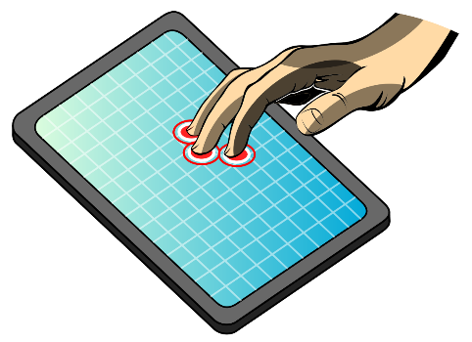
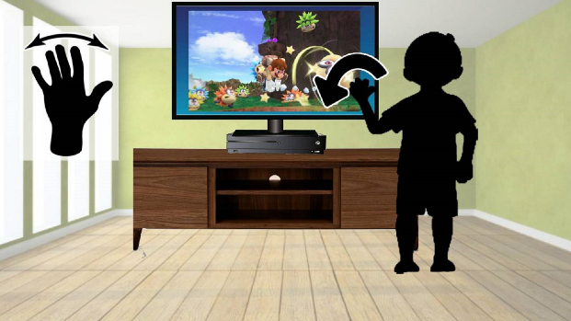
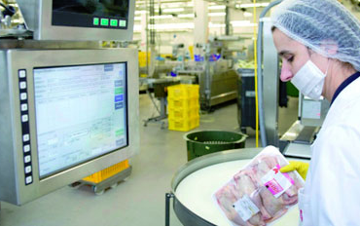
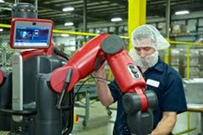
Introduction
Human-Computer Interaction techniques are enhancing
Touch and non-touch system
Touch device
Non-touch device
Touch devices: Limitations and Drawbacks
Unhygienic or unsafe
Security problems in user interference
Where the user cannot touch any device
Industrial environment
Notes:
human computer interaction techniques are enhancing.
There are many touch and non-touch devices, for example tablet display, smartphone,
Touch devices have Limitations and Drawbacks
This is Unhygienic or unsafe
Security problems happen in user interference
In Where the user cannot touch any device in some industry.
近年、人間とコンピュータのインターフェイスが強化されており、
タブレットやスマートフォン等のさまざまな接触型、非接触型デバイスがあります
接触型デバイスには
衛生上の安全性の問題
生体情報のセキュリティーの問題
ユーザーがデバイスを触ることができない場面で使用できない
などの欠点や限界があります

Slide 9
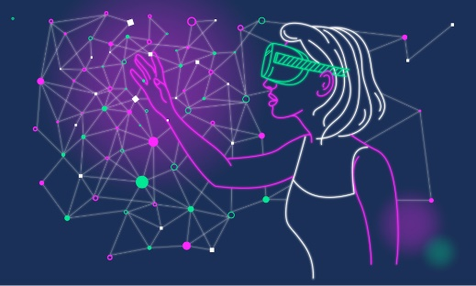
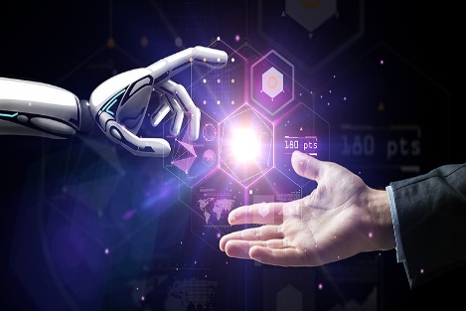
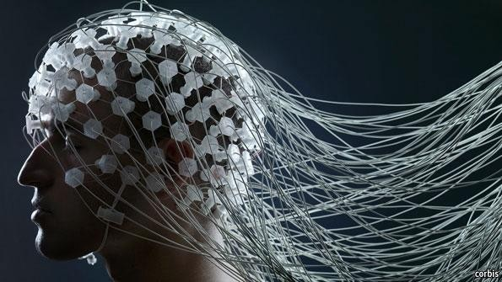
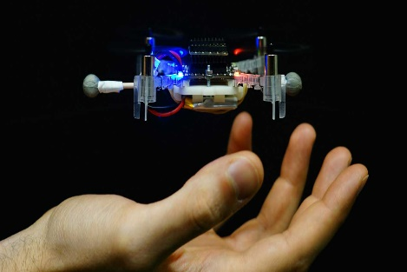
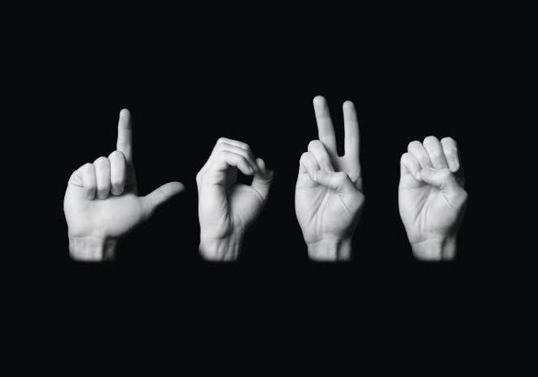
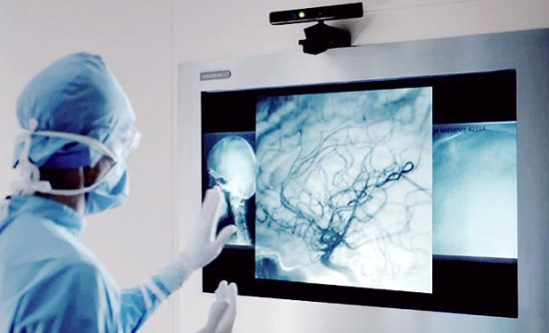
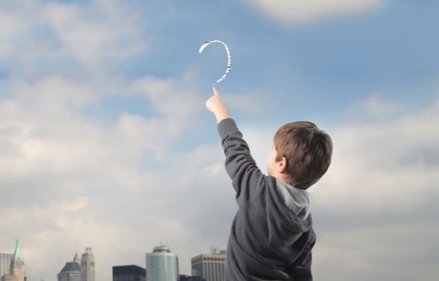

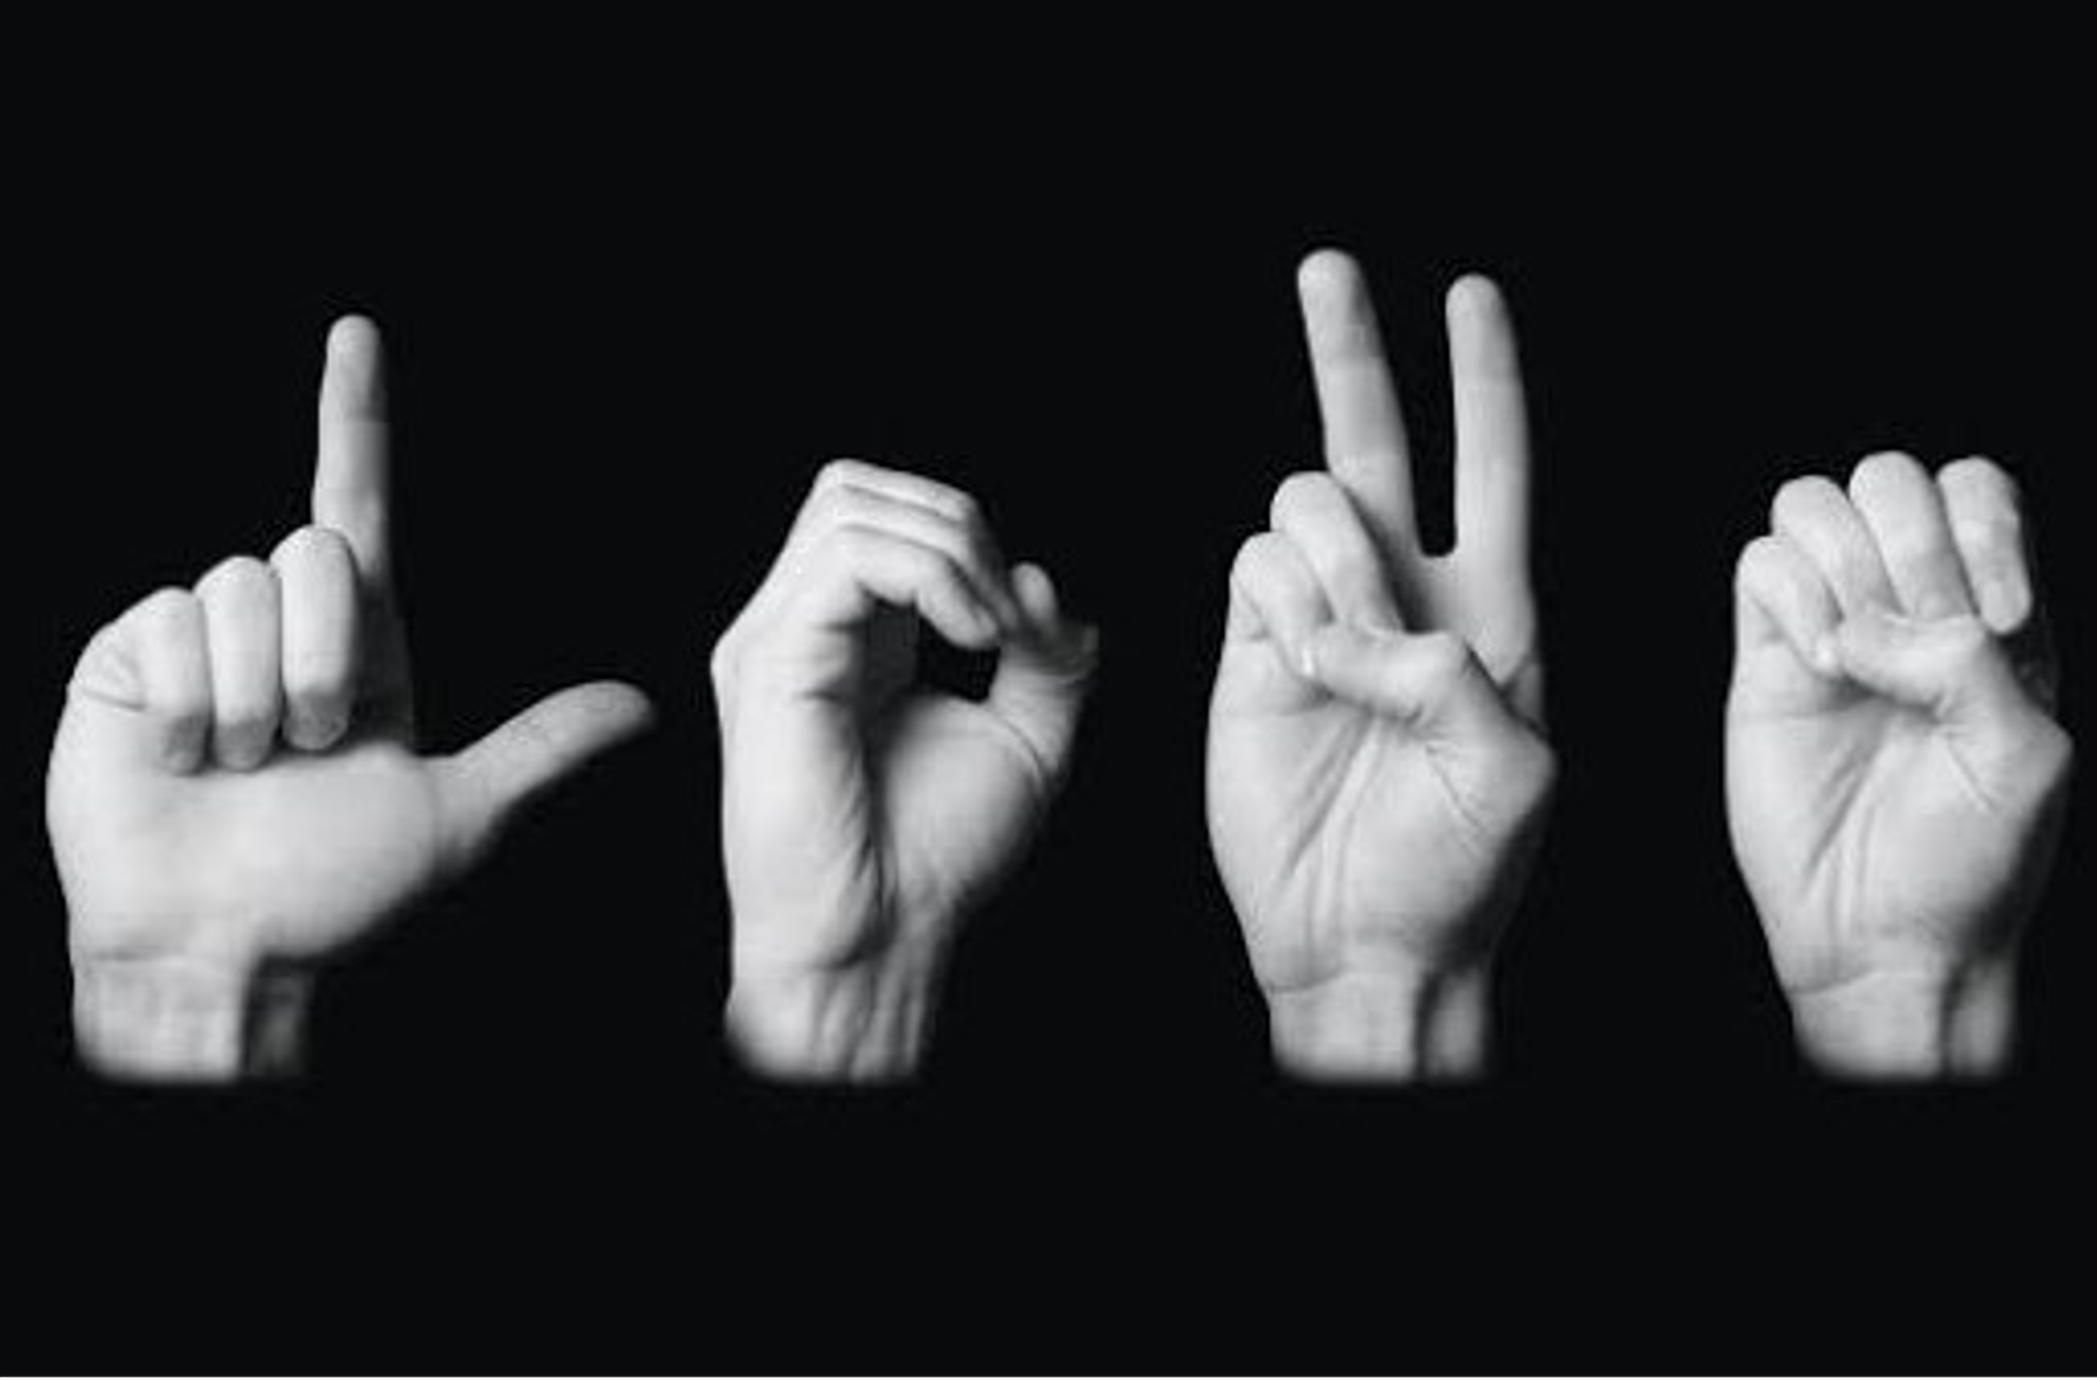
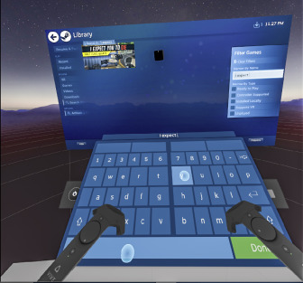

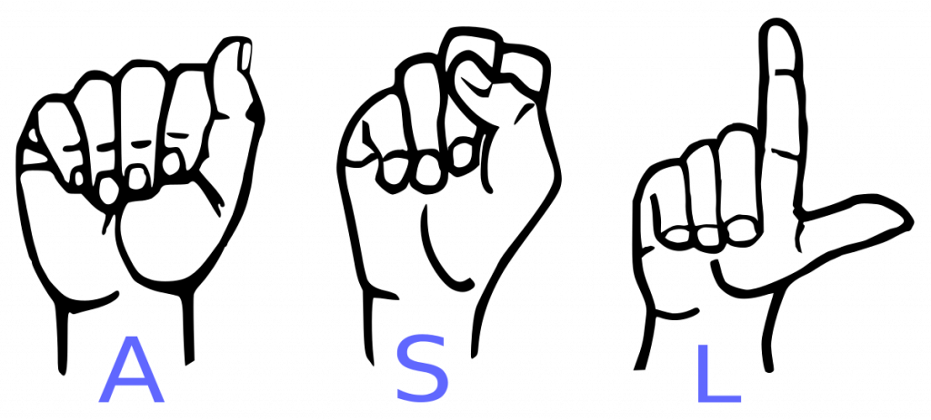
Introduction (Cont.)
Non-touch techniques, the user does not need to
Type on a keyboard
Write on a trackpad/touch screen
control smart/robot systems from insecure locations.
Applications
Virtual Reality
HCI
BCI
Touch-free Interface
Air writing
SLR
Medical Diagnosis
Character Input
Notes:
In non-touch techniques, the user does not need to type on a keyboard, write on a trackpad/touch screen, or control a smart system.
There have been many application of non-touch systems, such as virtual reality, HCI, brain-computer interface, touch free writing, aerial handwriting, sign languages recognition, medical application, char input. etc.
Today I will present on SLR.
ノンタッチ技術を使うことで
ユーザーはキーボードで入力したり、
トラックパッドやタッチスクリーンで書いたり制御したりする必要がなくなります。
これまでにも、仮想現実、人間とコンピュータのインターフェイス、脳とコンピュータインターフェース、非接触インターフェイス、
空中手書き、手話認識、医療アプリケーション、文字入力など、様々な場面で応用されてきました。

Slide 10
Background
Recently, some researchers have used attention-based approaches to improve performance accuracy and reduce the computational complexity
The main advantage of the attention-based method is that it usually highlights the potential feature during discards the irrelevant feature with the self-supervised learning
However, very few attention-based methods are used to recognize kinetic RGB based hand gesture recognition, and their performance is unsatisfactory.
Purpose
Multistage spatial attention-based neural network to improve sign language recognition performance accuracy.
Develop an attention-based effective feature extraction and CNN classification module
Notes:
I will talk about background of this research. We usually use a variety of methods to input text. One of the main examples is keyboard input. Keyboard input is the current mainstream input method and is used by many people. However, keyboards can come into contact with an unspecified number of people. It is said that many bacteria exist on a keyboard that has not been sterilized, and this is a major drawback from a hygiene standpoint. In recent years, there has been a growing demand for non-contact interfaces that allow input without the hand touching the object. For example, there have been studies using various types of devices such as wearable sensors, cameras with built-in depth sensors such as Kinect, eye movements, and even leap motion. These devices allow users to input text without touching the keyboard. They are able to input text without touching is quite hygienic, and is expected to reduce the risk of contact infections. However, sensors with depth sensors such as kinect are expensive and not very convenient to use.

Slide 11
Previous study
Reference | Method | Dataset | No. of Image | Accuracy(%)
Kumar et al[1] | HMM, BLSTM-NN | 20-ISL | 7500 | 97.85, 94.55
Li Y et al.[2] | MSHMM | 120- CSL | 13920 | 96.5
Tubaiz et al. [3] | MKNN | 40-ArSL | Sensor data | 98.9
Hu et al.[4] | SVM | 24-ASL | 120,000 | 91.6
Lee et al[5] | SVM | 28-ASL | Sensor data | 98.2
Ta et al [6]. | CNN | 24-ASL Alphabet | 600 | 84.8
Naguri [6] | LSTM-CNN | Leap Motion (LM) | 97 Trial Video | 97.00
Juan [7] | LSTM+CNN | 3D Data Hand Skeleton | Small Dataset | 87.74
Zhou Ren [8] | Template-matching | NTU |  | 93.20
PG2 [9] | Pose-guided person generation network | NTU/Senz3D |  | 93.66 / 98.73
Yan et al. [10] | CNN | NTU/Senz3D |  | 95.33 / 99.49
Ma et al. [11] | CNN | NTU/Senz3D |  | 95.86 / 99.05
PoseGAN [12] | CNN | NTU/Senz3D |  | 96.12 / 99.54
GestureGan [13] | Generative adversarial network | NTU/Senz3D |  | 99.66 / 99.74
Marine [14] | SVM | Kinematic |  | 89.70
Marine [15] | SVM | Kinematic |  | 96.30
Table 1. Previous works performances at a glance including the approach and classifier used.

Slide 12
Previous study
Kumar P, Gauba H, Roy PP, Dogra DP. A multimodal framework for sensor based sign language recognition. Neurocomputing. 2017 Oct 11;259:21-38.
Li Y, Chen X, Zhang X, Wang K, Wang ZJ. A sign-component-based framework for Chinese sign language recognition using accelerometer and sEMG data. IEEE transactions on biomedical engineering. 2012 Mar 16;59(10):2695-704.
Tubaiz N, Shanableh T, Assaleh K. Glove-based continuous Arabic sign language recognition in user-dependent mode. IEEE Transactions on Human-Machine Systems. 2015 Mar 16;45(4):526-33.
Hu, Y. Finger spelling recognition using depth information and support vector machine. Multimed Tools Appl 77, 29043–29057 (2018). https://doi.org/10.1007/s11042-018-6102-6
Lee BG, Lee SM. Smart wearable hand device for sign language interpretation system with sensors fusion. IEEE Sensors Journal. 2017 Dec 4;18(3):1224-32.
Naguri, C.R.; Bunescu, R.C. Recognition of dynamic hand gestures from 3D motion data using LSTM and CNN architectures. In Proceedings of the 2017 16th IEEE International Conference on Machine Learning and Applications (ICMLA), Cancun, Mexico, 18–21 December 2017; pp. 1130–1133.
Juan C. Núñez, Raúl Cabido, Juan J. Pantrigo, Antonio S. Montemayor, José F. Vélez, Convolutional Neural Networks and Long Short-Term Memory for skeleton-based human activity and hand gesture recognition,Pattern Recognition,Volume 76,2018,Pages 80-94.
Tao, W.; Leu, M.C.; Yin, Z. American Sign Language alphabet recognition using Convolutional Neural Networks with multiview augmentation and inference fusion. Eng. Appl. Artif. Intell. 2018, 76, 202–213.
Shotton, J.; Fitzgibbon, A.; Cook, M.; Sharp, T.; Finocchio, M.; Moore, R.; Kipman, A.; Blake, A. Real-time human pose recognition in parts from single depth images. In Proceedings of the CVPR 2011, Colorado Springs, CO, USA, 20–25 June 2011; pp. 1297–1304.
Ma, L.; Jia, X.; Sun, Q.; Schiele, B.; Tuytelaars, T.; Gool, L.V. Pose Guided Person Image Generation. In Proceedings of the Advances in Neural Information Processing Systems 30 (NIPS 2017), Long Beach, CA, USA, 4–9 December 2017.
Yan, Y.; Xu, J.; Ni, B.; Zhang, W.; Yang, X. Skeleton-aided articulated motion generation. In Proceedings of the 25th ACM International Conference on Multimedia, Mountain View, CA, USA, 23–27 October 2017; pp. 199–207.
Ma, L.; Sun, Q.; Georgoulis, S.; Van Gool, L.; Schiele, B.; Fritz, M. Disentangled Person Image Generation. In Proceedings of the CVPR 2018 (IEEE), Salt Lake City, UT, USA, 18–23 June 2018; pp. 99–108.
Siarohin, A.; Sangineto, E.; Lathuilière, S.; Sebe, N. Deformable GANs for Pose-based Human Image Generation. In Proceedings of the CVPR 2018 (IEEE), Salt Lake City, UT, USA, 18–23 June 2018; pp. 3408–3416.
Siarohin, A.; Sangineto, E.; Lathuilière, S.; Sebe, N. Deformable GANs for Pose-based Human Image Generation. In Proceedings of the CVPR 2018 (IEEE), Salt Lake City, UT, USA, 18–23 June 2018; pp. 3408–3416.
[Siarohin, A.; Sangineto, E.; Lathuilière, S.; Sebe, N. Deformable GANs for Pose-based Human Image Generation. In Proceedings of the CVPR 2018 (IEEE), Salt Lake City, UT, USA, 18–23 June 2018; pp. 3408–3416.
Marin, G.; Dominio, F.; Zanuttigh, P. Hand gesture recognition with jointly calibrated leap motion and depth sensor. Multimed. Tools Appl. 2016, 75, 14991–15015.

Slide 13
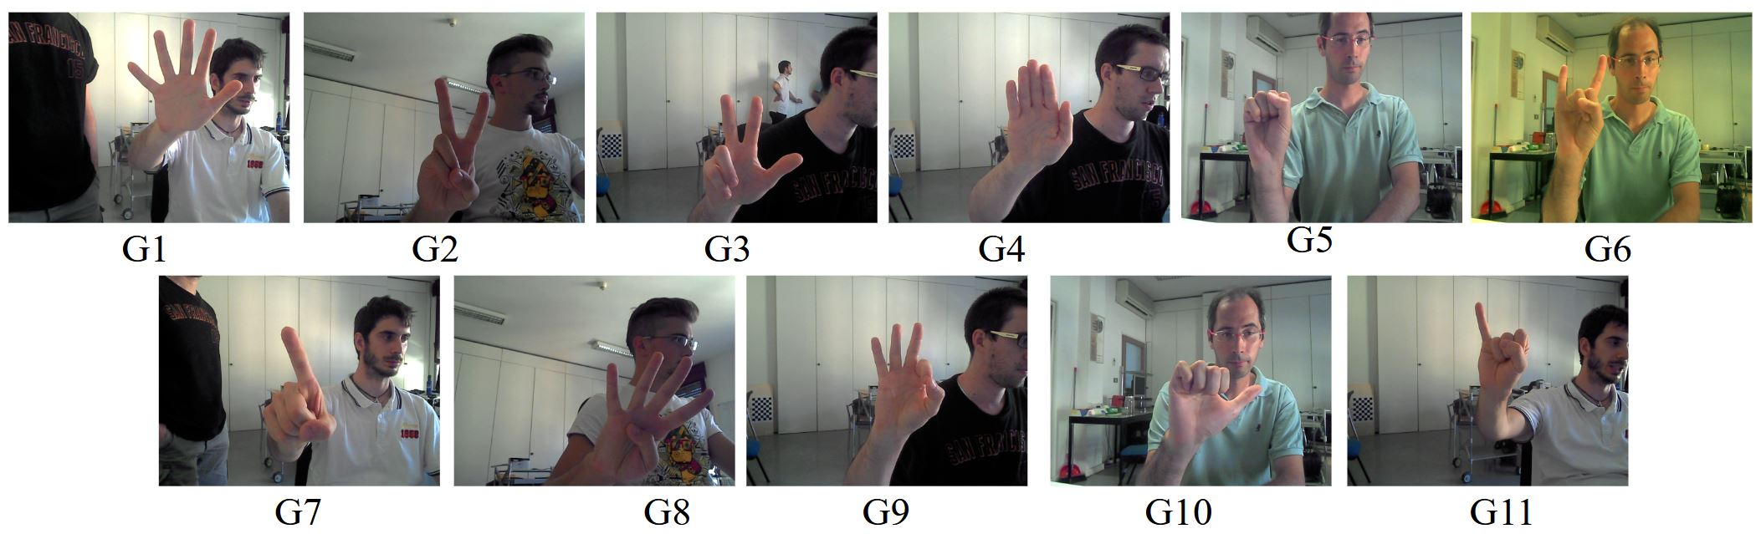
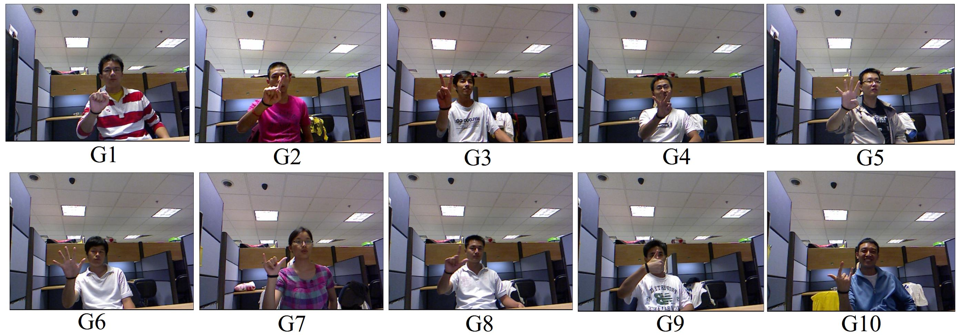
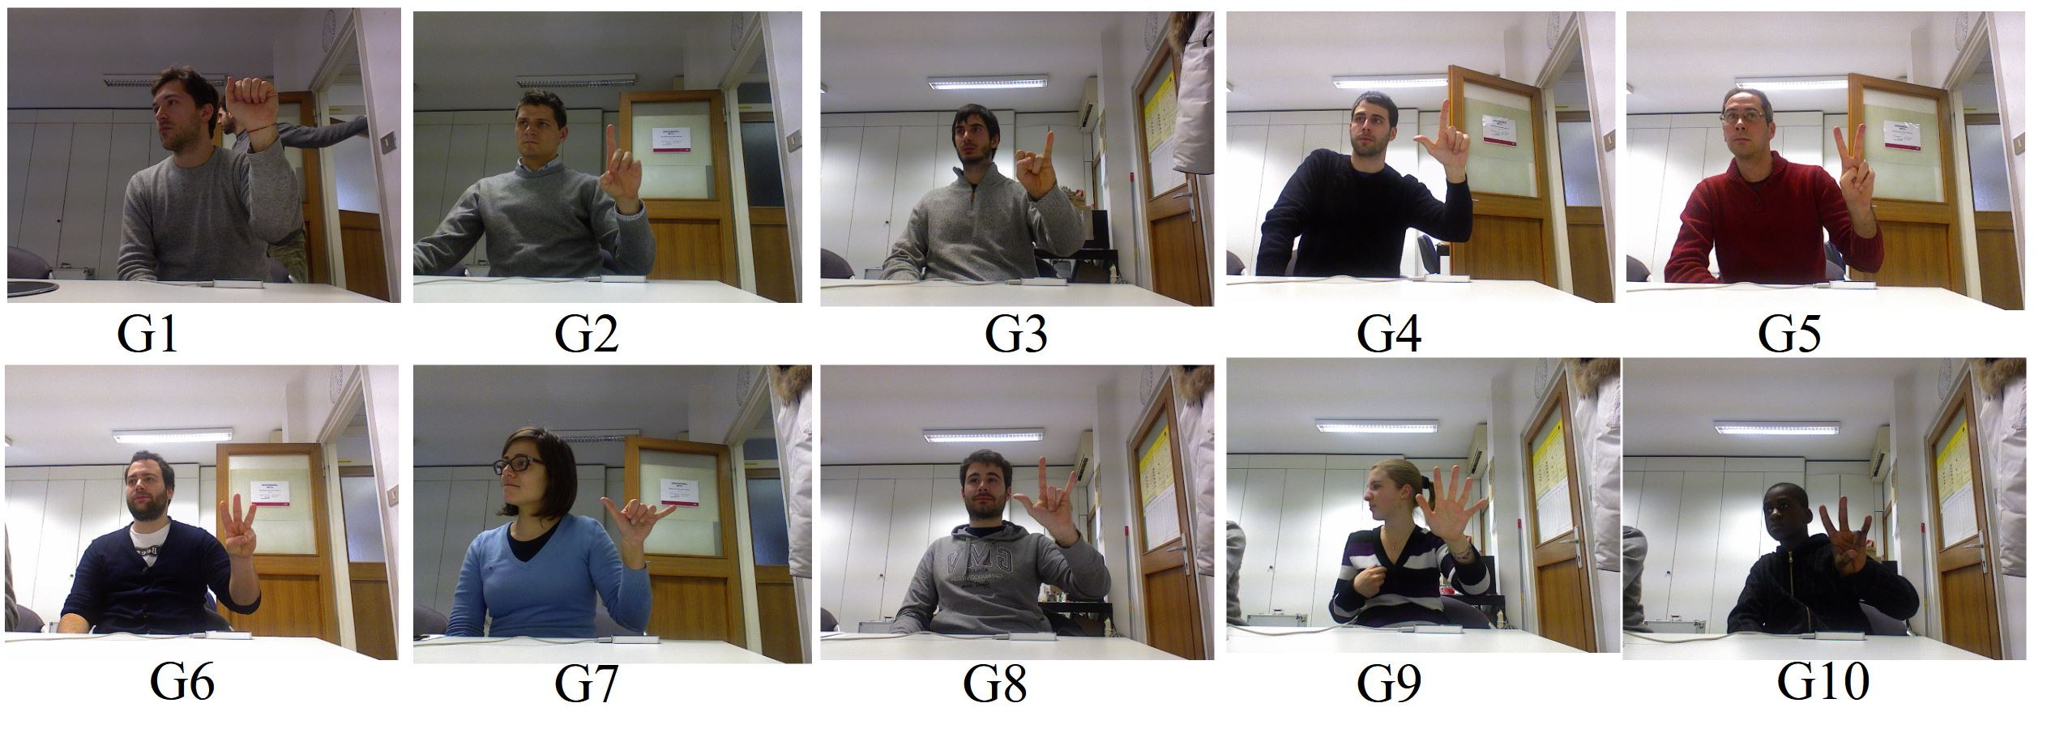
Dataset
Creative Senz3d Dataset
11 different gestures
4 different people perform
30 repetition from each people
3200 sample for each gestures
NTU Dataset
10 different gestures
0 to 9 digit
1000 images in the dataset.
Kinetic and Leap Motion Dataset
10 different gestures
14 people
1400 data sample

Slide 14
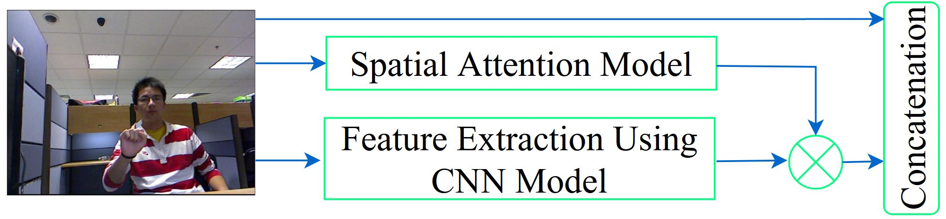
Working Flowgraph
Figure 1: Working Flow Architecture
Our main goal is to produce a combined feature by including spatial feature, CNN feature and Original for recognizing sign language.
Firstly, we multiplied the Spatial attention feature and CNN feature
We concatenated the multiplied feature with the original feature which reached here with a skip connection.

Slide 15
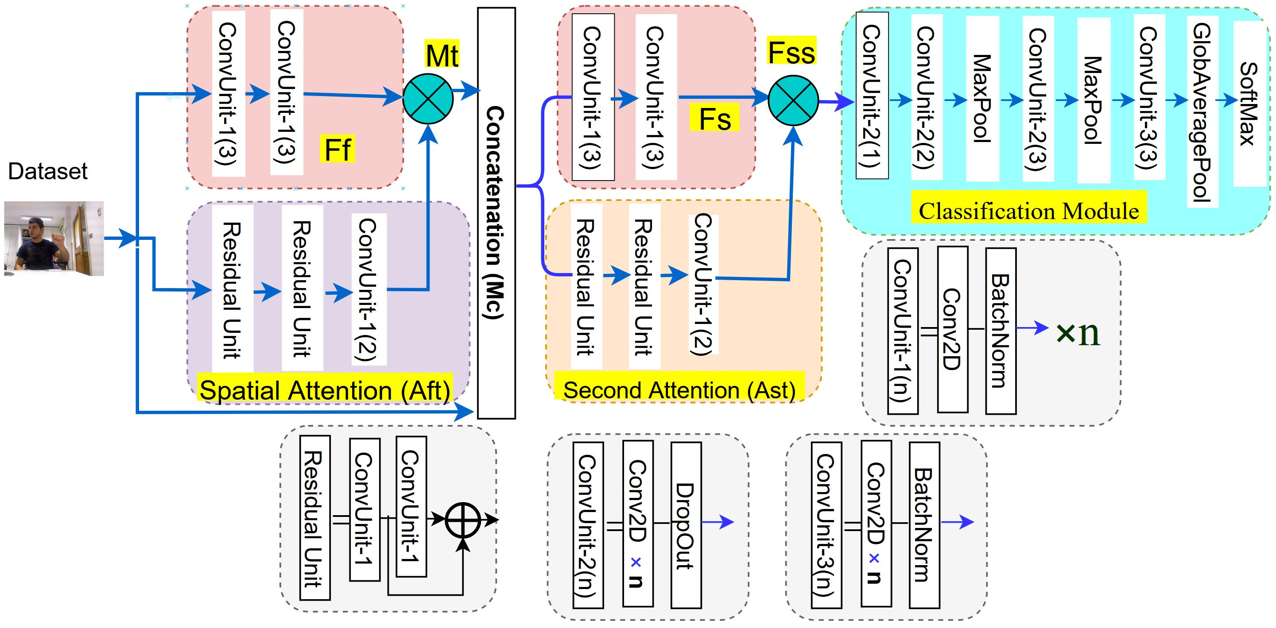
Working Flowgraph
Figure 2: Working Flow Architecture in Details
We repeated used the first stages as second stages to high light the spatial feature of the dataset.
In the last stage we used a CNN based classification model.
The first phase is used to extract spatial features, the second phase is used to highlight effective features.

Slide 16
Performance result of the Senz3D and NTU dataset
Each dataset we divided 70% as a training and 30% as a testing
Google Collabulary which have, 25GB GPU in the processing RAM in the environment, known as Tesla P100
We used TensorFlow python package.
Previous CNN, LSTM and Attention based model produced good performance
Our Multi-stage model produced high accuracy compared to the existing system.
Method | NTU [3] (%) | Senz3D[4] (%)
Zhou Ren [6] | 93.20 | Na
PG2 [7] | 93.66 | 98.73
Yan et al. [8] | 95.33 | 99.49
Ma et al. [9] | 95.86 | 99.05
PoseGAN [10] | 96.12 | 99.54
GestureGan [11] | 96.66 | 99.74
Proposed Model | 99.67 | 99.75
Table 1. Classification accuracy (%) of the proposed method with Senz3D and NTU dataset and state of the art comparison

Slide 17
Performance with Kinematic Dataset
Previous feature extraction method with SVM also produced good performance but not satisfiable.
Our Multi-stage model produced high accuracy compared to the existing system for the Kinematic dataset.
Method | KLP (%)
SVM [14] | 89.70
SVM [24] | 96.30
Proposed Model | 99.46
Table 2. Classification accuracy (%) of the proposed method with Kinematic dataset and state of the art comparison

Slide 18
Conclusion
We proposed a multistage spatial attention-based neural network for hand gesture recognition, producing a high performance for multiple datasets.
Our proposed architecture utilizes different attention-learning models to learn the joint representation of the RGB modality.
Our model achieved good performance compared to the existing method.
The performance from multiple datasets proved the efficiency of the proposed model.
In future work, we plan to extend the neural network model to support more than two modalities for hand gesture recognition with real-time implementation.

Slide 19
Thank you for your kind attention

